Slide 1
Lipschitz Bounding for Robustness - Overview
Emil Bark Kvamme, M2, NTNU

Slide 2
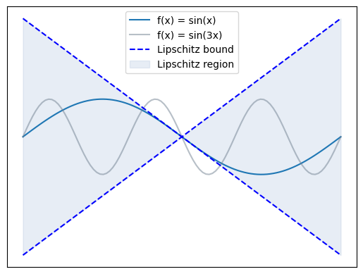
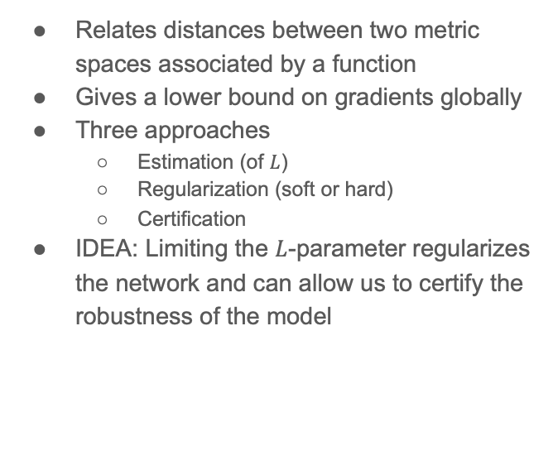

Lipschitz Continuity
$${\left|\left|f\left(x_{1}\right)−f\left(x_{2}\right)\right|\right|}_{l_{p}}≤L{\left|\left|x_{1}−x_{2}\right|\right|}_{l_{q}}$$
Relates distances between two metric spaces associated by a function
Gives a lower bound on gradients globally
Three approaches
  Estimation (of $L$)
  Regularization (soft or hard)
  Certification
IDEA: Limiting the $L$-parameter regularizes the network and can allow us to certify the robustness of the model

Slide 3
Lipshitz Network: Current technical implementations
Most of the work is done on FFTs or CNNs
  Nothing on particle clouds, a little on transformers
Approach: Layerwise or entire network parametrization
Sandwhich layers
  Not compared with the others methods yet
  Outperforms Spectral Normalization on certain reinforcement learning problems
Block orthogonal convolution parametrization
Caley transform based
Skew Orthogonal Convolution
Almost Orthogonal Lipschitz (AOL) layers
Layer-wise Orthogonal Training (LOT)
Convex Potantial Layer (CPL)
SDP-based Lipschitz Layers (SLL) (Arujo)
Modular usage in layers ensures complete Lipschitz bounded network
On manifolds:
  https://arxiv.org/abs/2607.19335
  Learning Smooth Neural functions via Lipschitz Regularization: https://arxiv.org/abs/2202.08345

Slide 4
Technical approaches
Layer-wise
h
Full network parametrization
.

Slide 5
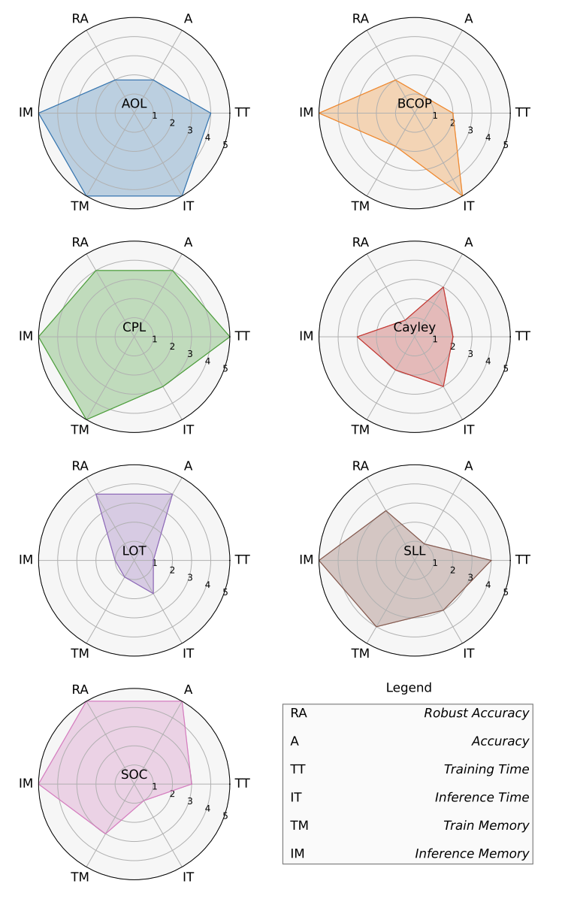
Performance
1-Lipschitz Layers Compared: Memory, Speed, and Certifiable robustness
  https://arxiv.org/abs/2311.16833v1
1-Lipschitz Layers Compared: Memory, Speed, and Certifiable robustness
https://arxiv.org/abs/2311.16833v1

Slide 6
Note on the activation functions
The problem of ReLu
GroupSort
Linear Splines
MinMax
N-activations https://arxiv.org/html/2311.06103v2
Others???
Conclusively: Some work will need to be done to select tha appropriate activation function

Slide 7
Applications
High Energy Physics => LHCb trigger:
  Robust and Provably Monotonic Networks arXiv:2112.00038 (15.03.2023)
  Development of the topological trigger for LHCb run 3 arXiv:2306.09873 (20.06.2023)
  Applications of Lipschitz Neural Networks to the run 3 LHCb trigger system arXiv:2312.14265 (21.12.2023)
  Real time lepton-identification at the LHCb in run 3 using Lipschitz neural networks arXiv:2609.07903 (07.09.2026)
Others
  Wasserstein GANs are by construction 1-Lipschitz constrained

Slide 8
Conclusive remarks
As far as I can find, most energy has been put into fully forward and convolutional networks
  Some work has been put into transformers and certain reinforcement learning methods
  Particle cloud methods are less explored and presents a possible frontier
Lipschitz bounding seems to be a good alternative to methods like Random…
  It is less computationally intensive both at inference stage and at training, but looses some tightness towards…

Slide 9
Supplementary Slides
Spectral Bias: the learnable modes are initially low frequency.
Semi-definite programming (SDP)
NP-hardness of the Lipschitz constant
Other Regularization Approaches
Review of todays standing: https://arxiv.org/pdf/2607.16329v2

Slide 10
Spectral Bias: Preference for low frequency modes

Slide 11
Lipschitz + Spectral Bias: Combination Strategies

Slide 12
Bibliography

